Slide 1
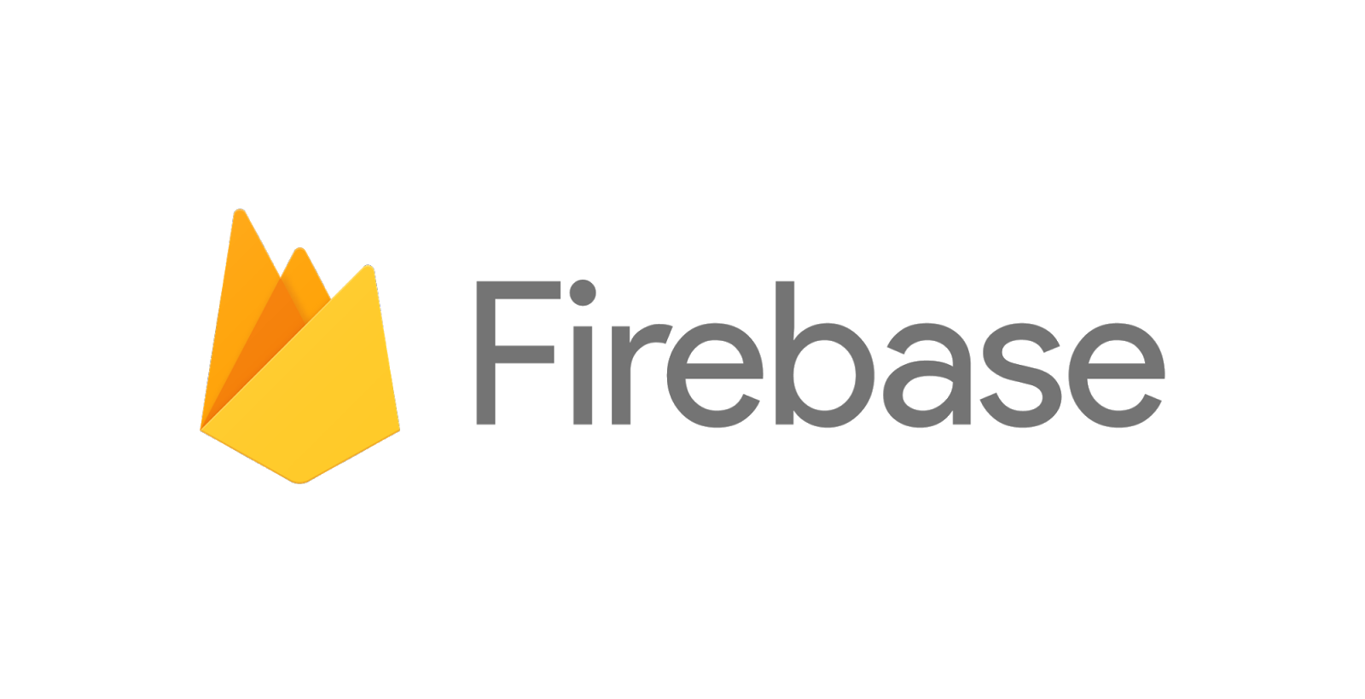


Cloud Messaging
Notes:
#43 Mobile Monday
Sponsors
Startup hr
ITC zupanija
Jet Brains
Lil code lab

Slide 2








Speaker
Božo Penović – web developer
MCP (Microsoft Certified Professional)
Email: bozo.penovic@lilcodelab.com
Github / bpenovic
LinkedIn / bozo-penovic
Lilcodelab
Web: lilcodelab.com
Email: info@lilcodelab.com
Twitter / @lilcodelab
Facebook / lilcodelab
LinkedIn / lilcodelab
Notes:
About me
How did you start working with Firebase
About company (aps.net (web & api), Xamarin…)

Slide 3

Notes:
And that’s Firebase! Let’s start!
It’s our set of tools to help you develop high-quality apps, grow your user base and earn money. Firebase covers the essentials so that you can focus on your users and your business.

Slide 4
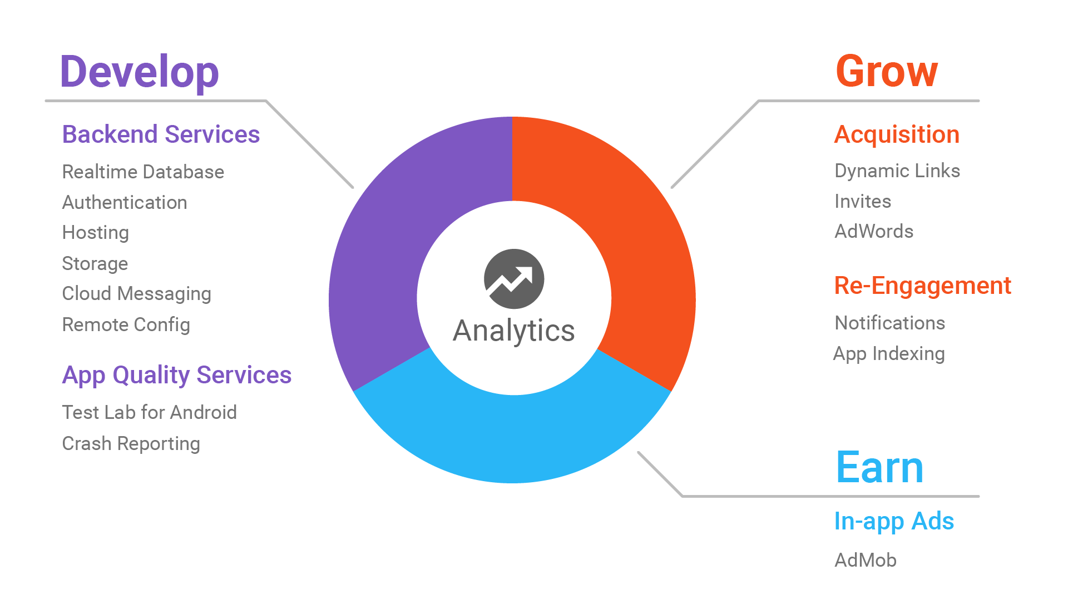
Notes:
Firebase -- 15 technologies that will help you Develop, Grow and Earn from your mobile apps, and an Analytics product that can be used to bring them all together.
TODO

Slide 5
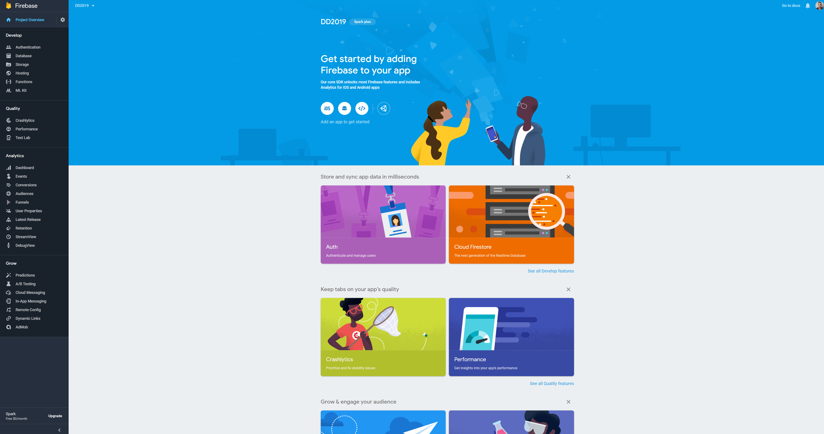

Slide 6
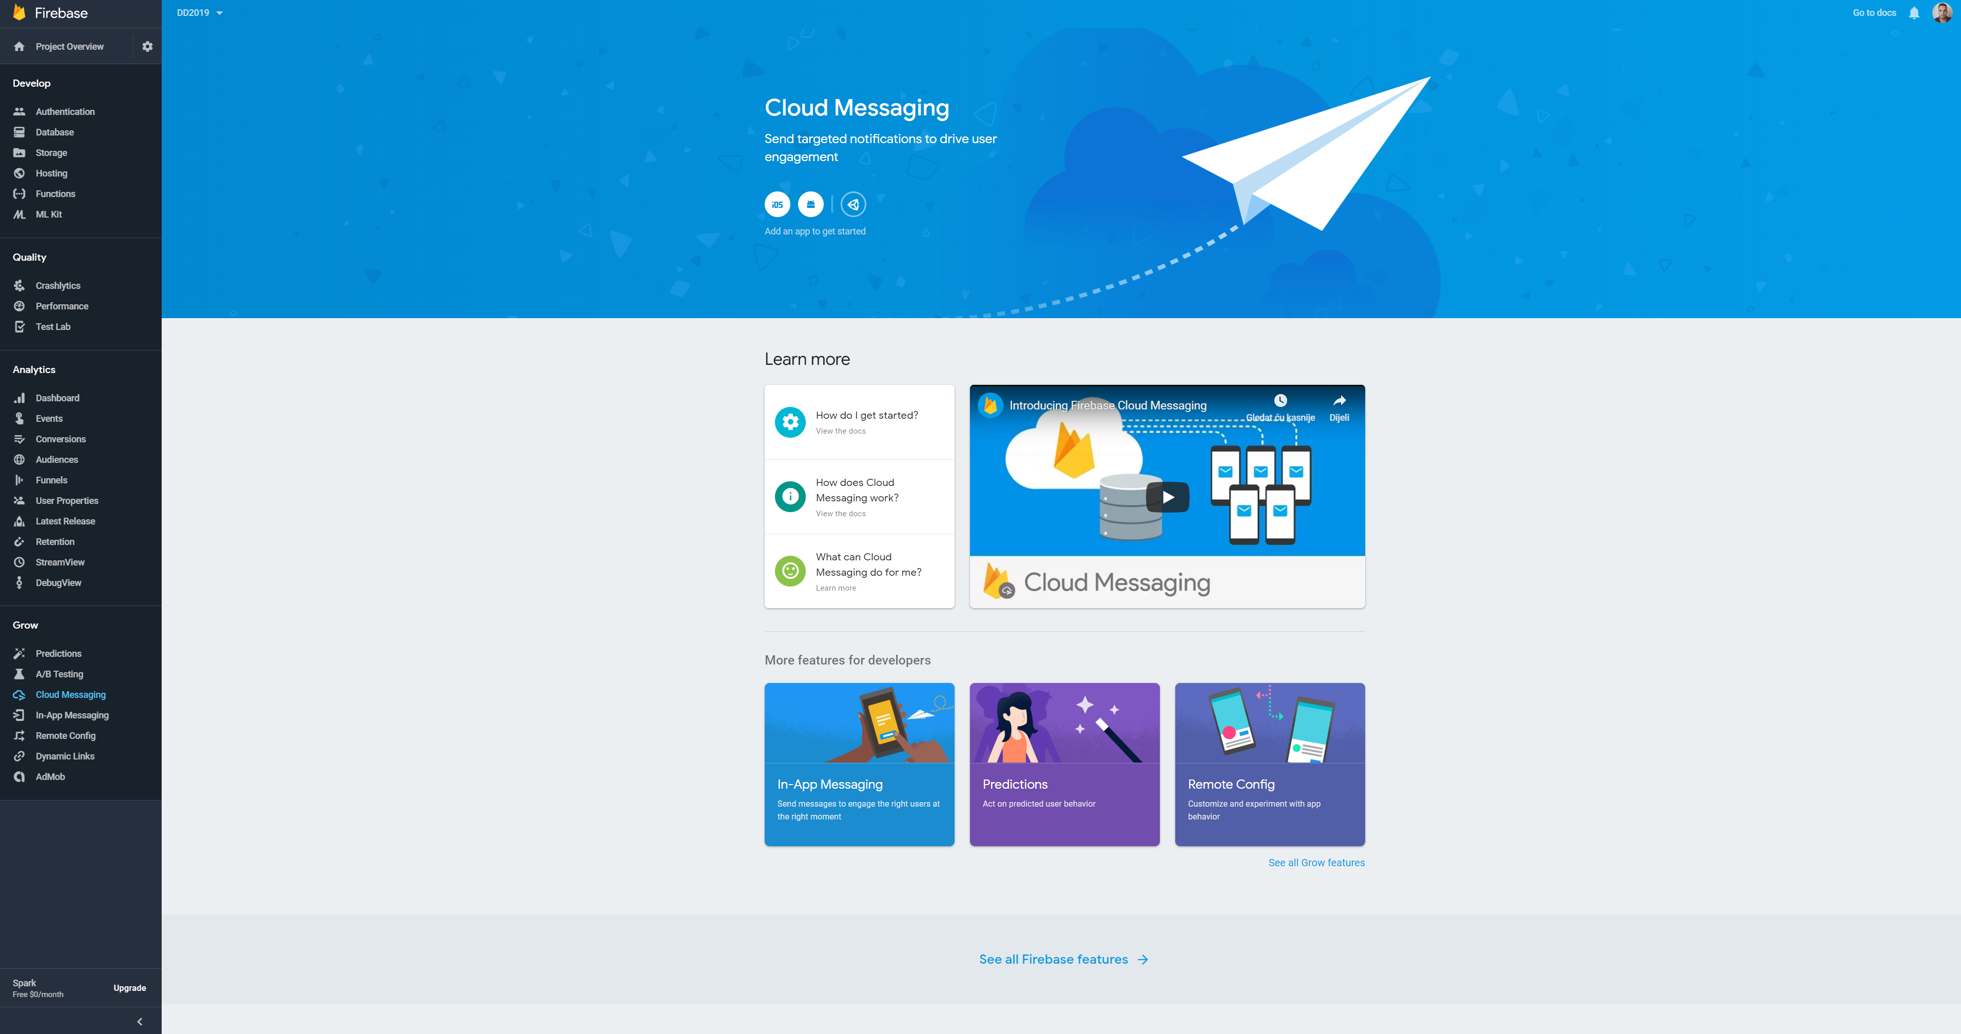
Notes:
Here we can see analytics from a game -- when you use Firebase in your app you get a bunch of analytics out-of-the-box that work without you writing any specific code for them. It’s a great way to look at usage for your app, and experiment with analytics without needing to do any coding!
You can see more about analytics on https://firebase.google.com/docs/analytics/ [Or attend the analytics session if there is one]

Slide 7

Developing your App
Notes:
Let’s now look at the tools available to develop an app.

Slide 8
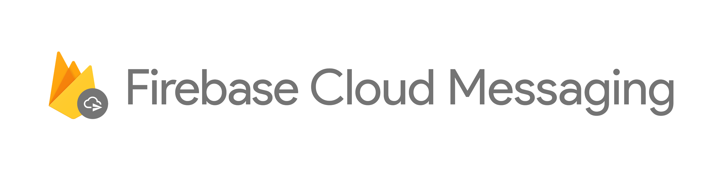
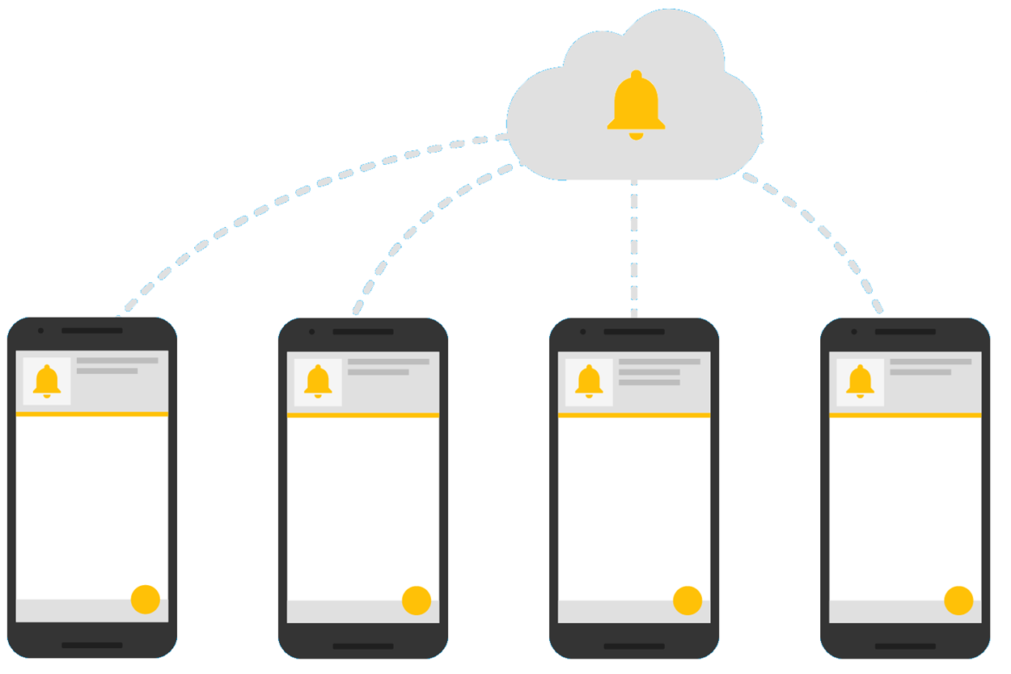
No Cost cross-platform messaging solution
Notifications to drive user interaction
95% of the messages delivered in 250ms
Notes:
Firebase Cloud Messaging (FCM) is a cross-platform messaging solution that lets you reliably deliver messages and notifications at no cost.
TODO

Slide 9

Growing a business
Notes:
In addition to developing an app, Firebase has tools to grow an app business.

Slide 10
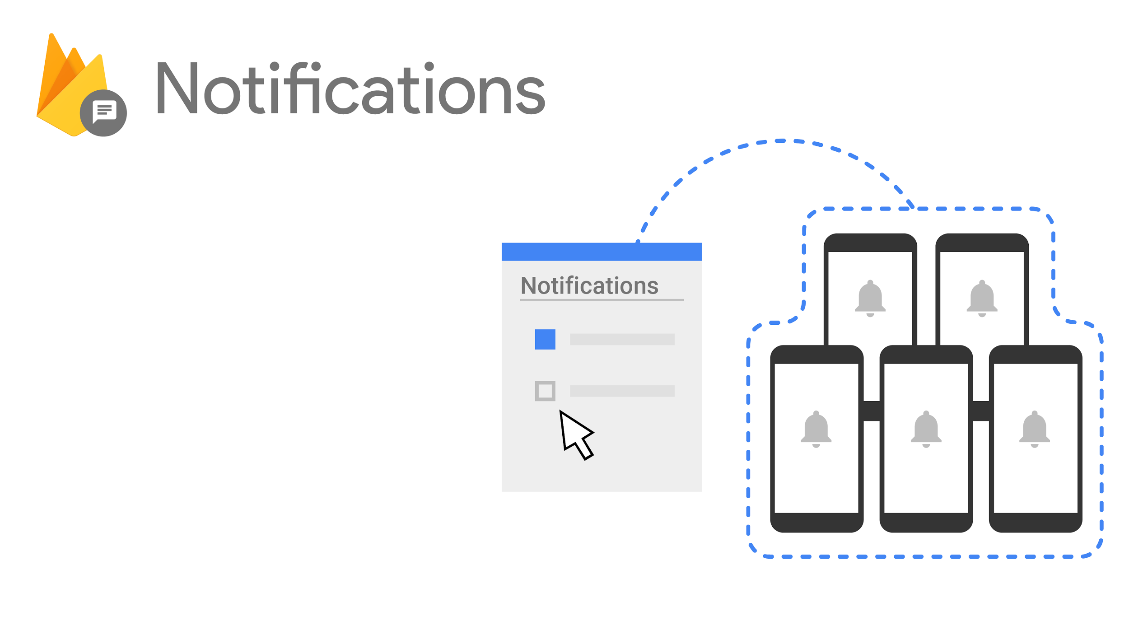

Free !
On mobile devices
Simple UI, with no coding
Built on Cloud Messaging
Invisible messages when app is active
Notes:
HERE GOES TECHNICAL STORY ABOUT NOTIFICATIONS
MENTION THAT FOR iOS NOTIFICATIONS, MESSAGES ARE SENT FROM FIRBASE INFRASTRUCTURE TO APPLE INFRASTRUCTURE
Firebase Notifications is a free service that enables targeted user notifications for mobile app developers.
It offers a very simple UI for generating notifications -- you don’t need to write code, you can use the Firebase notifications console.
It’s built on the same infrastructure as Firebase Cloud Messaging, so client code will work with either.
On the client -- for Android, no coding is needed for background notifications, and very little is needed for iOS or foreground ones.
Notifications can be tracked and measured with conversion funnel insights.

Slide 11
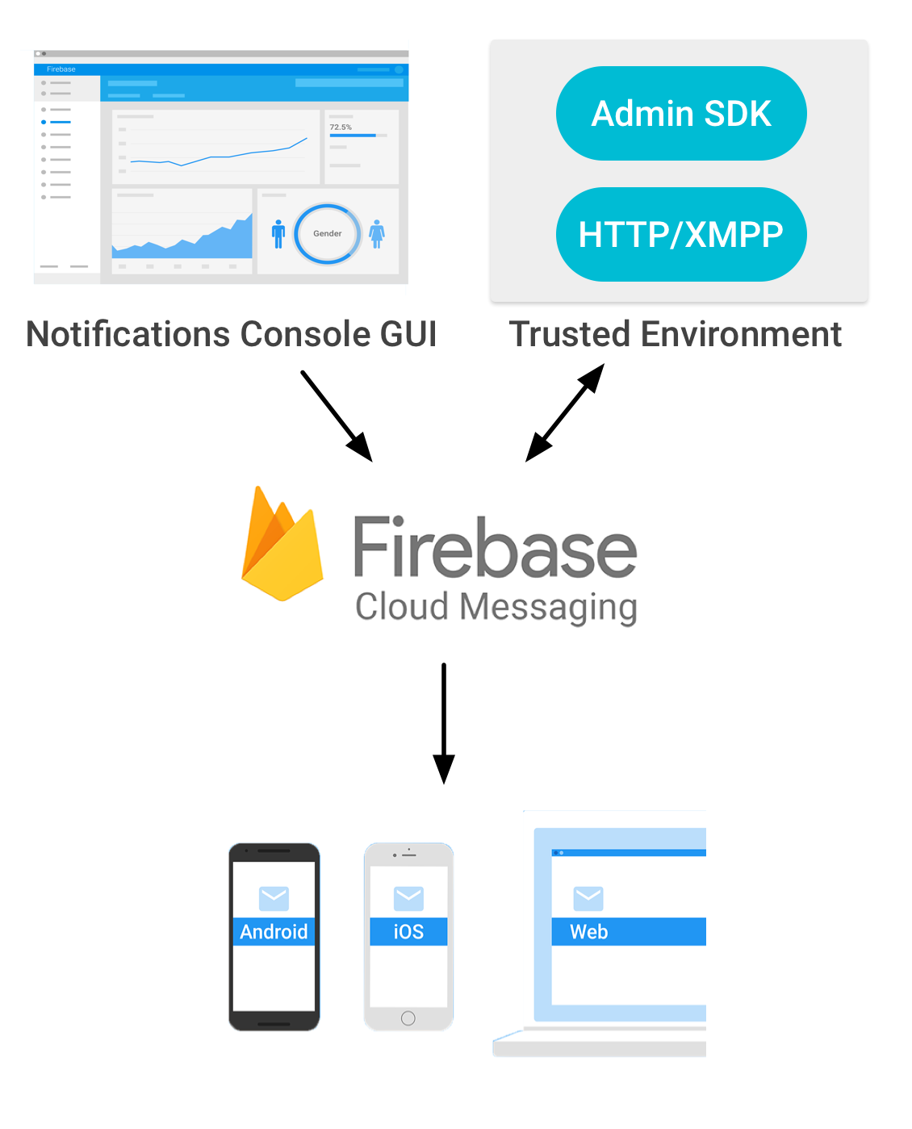
Audience targeting
Send to one or more devices
Send to one or more topics (user groups)
User can subscribe/unsubscribe to topic
Notes:
HERE GOES “SOFT STORY”, BUSINESS USE CASES…
IN CASE OF CHAT APP, WE’RE TARGETING SINGLE USER VIA TOKEN. – TALK ABOUT TOKEN MANAGEMENT, SAVING TO DB….
IN CASE OF NEWS/WEATHER/SHOP DISCOUNTS… APP WE ARE TARGETING ALL USERS SUBSCRIBED TO PARTICULAR TOPIC/CHANNEL

Slide 12
On web browser
Same simple UI, with no coding
This will be shown today

Slide 13
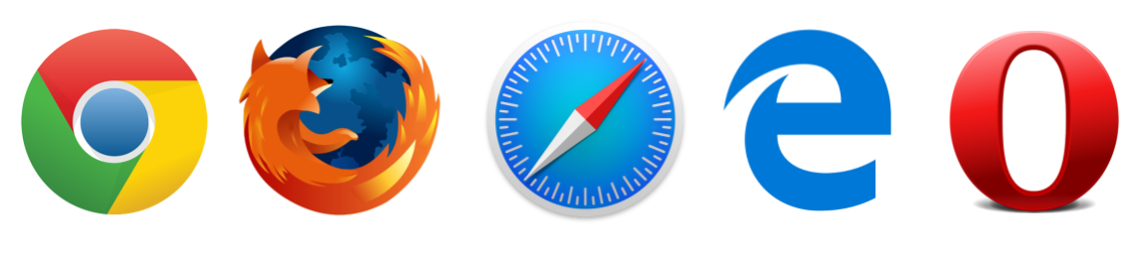
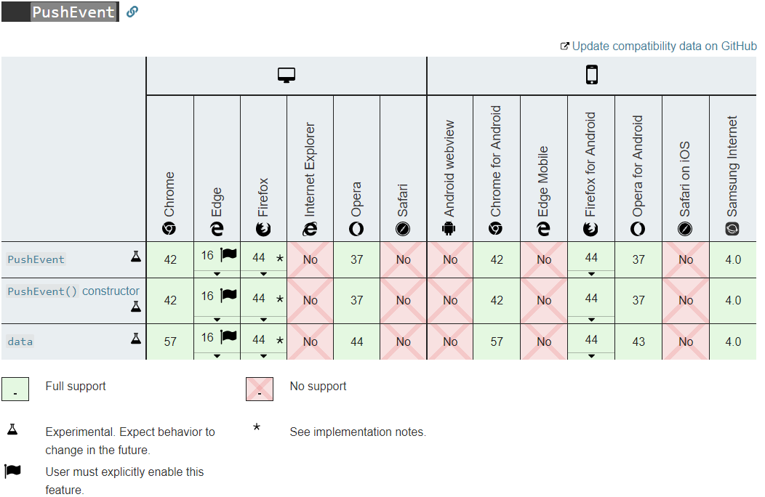
Browser compatibility
Image from developer.mozilla.org
Notes:
TODO

Slide 14
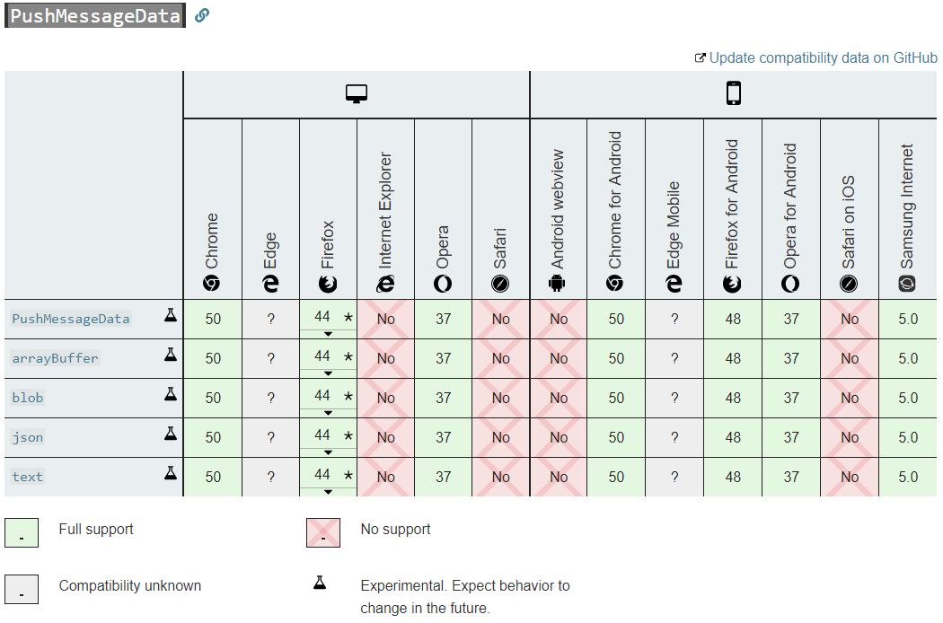
Browser compatibility
Image from developer.mozilla.org
Notes:
TODO

Slide 15
Our sample:
Azure cloud hosting
Azure SQL database
ASP.NET Core Web application
JS message receiving
Built in GUI

Slide 16
DEMO TIME

Slide 17
Migrate to HTTP v1 API
Advantages:
Better security via access tokens
More efficient customization of messages across platform
More extendable and future-proof for new client platform version
Notes:
TODO

Slide 18
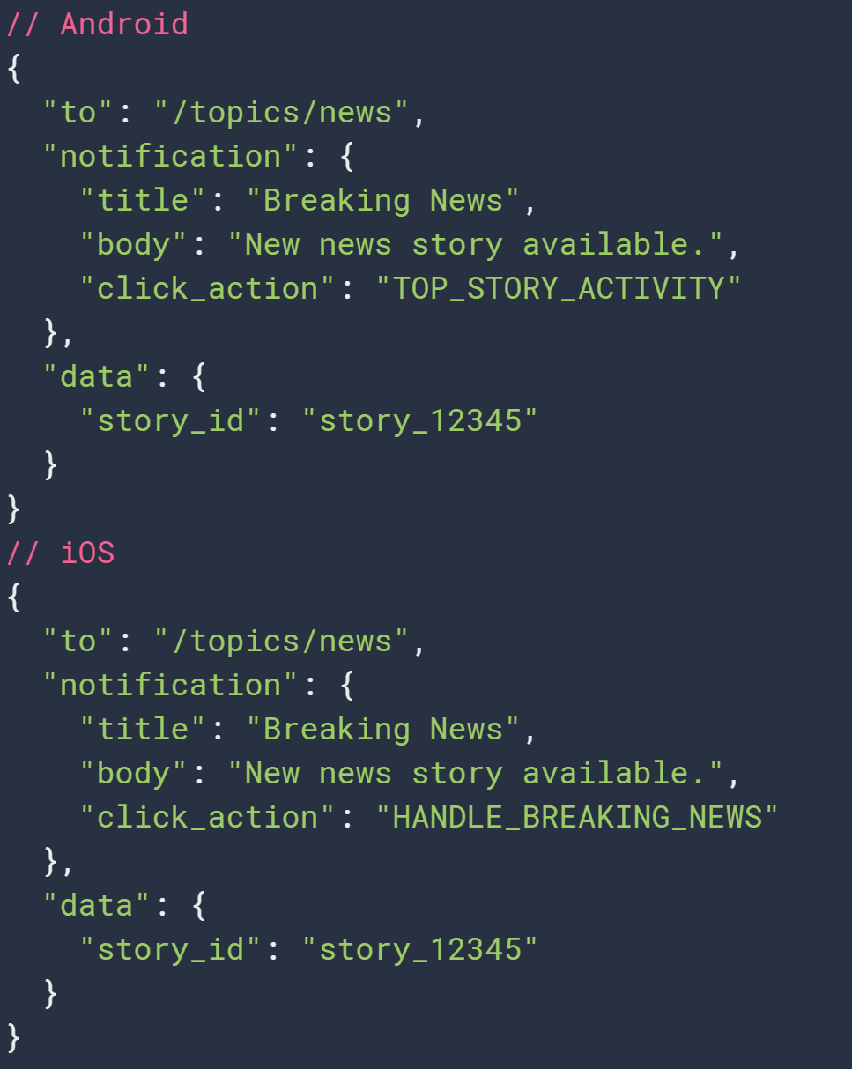
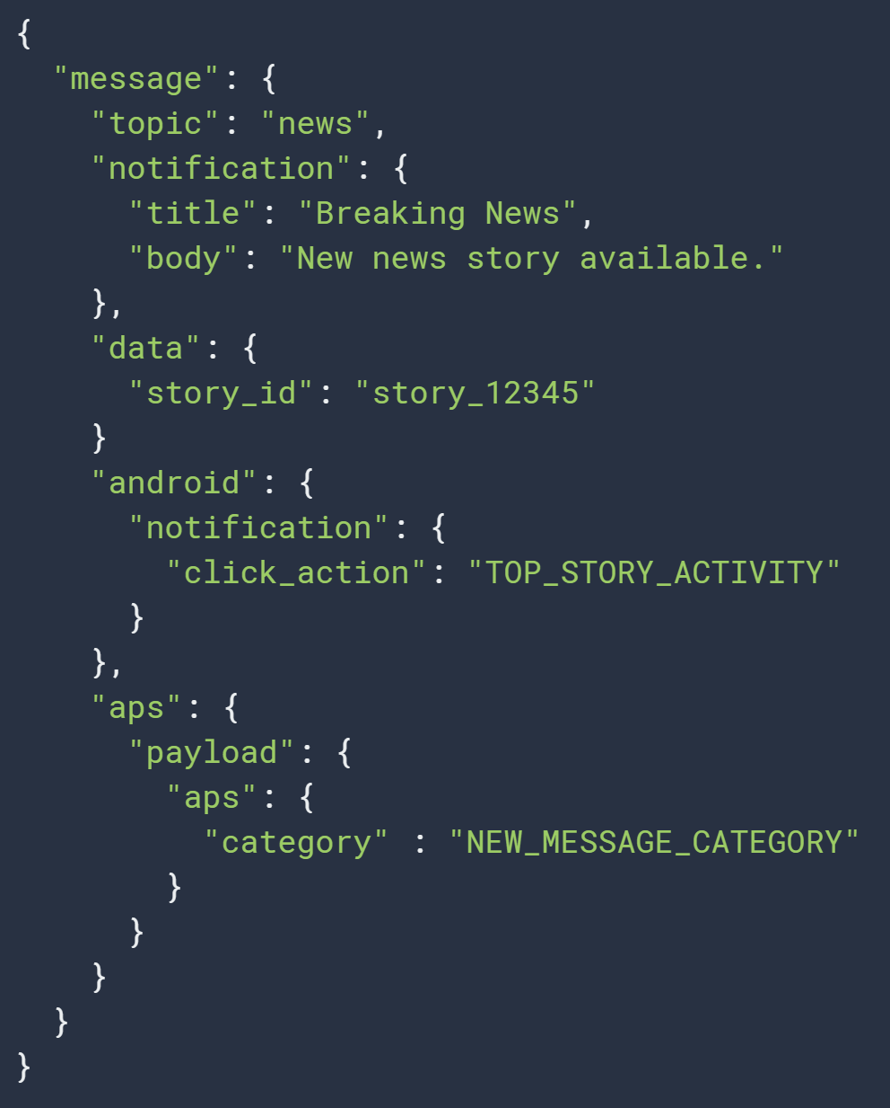
Before
After

Slide 19
QUESTIONS

Slide 20
References
Firebase: https://firebase.google.com/
Firebase documentation: https://firebase.google.com/docs/
This project on Github: https://github.com/bpenovic/Firebase-Cloud-Messaging

Slide 21
THANK YOU!
Notes:
Thank you!

